Slide 1

YEAR PLAN
CLASS III
2024-2025

Slide 2

Month | Lesson/Poem ( Paper 2) | Grammar ( Paper 1)
June | 1.Masha and the Bear 2.Why Nobody pets a Lion (Comprehension on Camping) | The Sentence , Subject and Predicate Nouns Types of nouns Singular and Plural Homophones
July | 2. Daddy long Legs (Poem) Picture Composition | Gender Similes Phrasal Verbs Pronouns
August | 3.Morning sports (poem) 4. Indian Games and Sports) | Demonstrative and possessive pronouns Verb tense Simple present/past / future tense
September | 5. Sound of the Sea The Bees and the Beehives (Comprehension) | Prefix and Suffix , Articles Letter writing- informal letter

Slide 3
Month | Lesson/Poem ( Paper 2) | Grammar ( Paper 1)
October | 6. With Green Thumbs… Bihu (Comprehension) | Adjectives Degrees of comparison
November | 8.The Joy of travel (Poem) The Farmer. His sons and the Donkey (Comprehension) | Adverbs ,Homonyms Paragraph Writing and Punctuation synonyms
December | 9. Dorothy in a strange Land | Prepositions
January | 10. Children don’t forget (Poem) Emperor’s new clothes (Comprehension) | Tenses – Simple Present/ Past Continuous Conjunctions

Slide 4
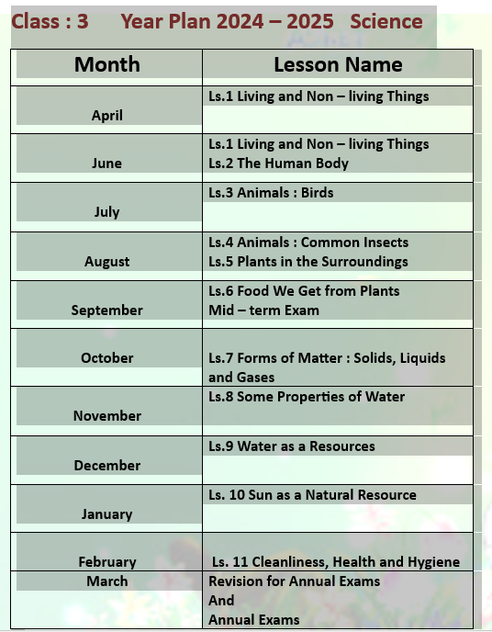

Slide 5
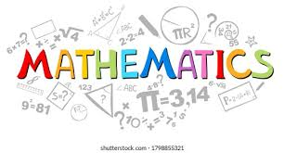
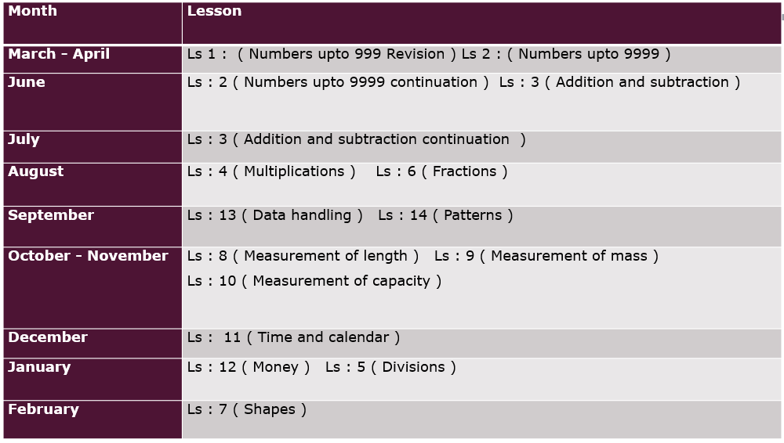

Slide 6




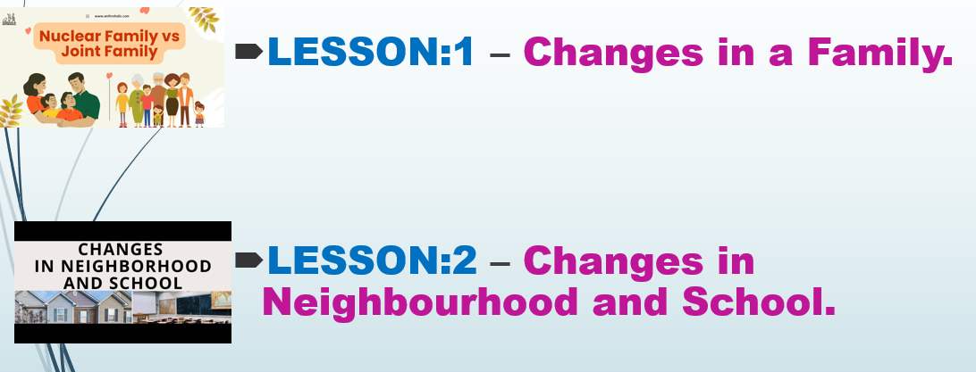





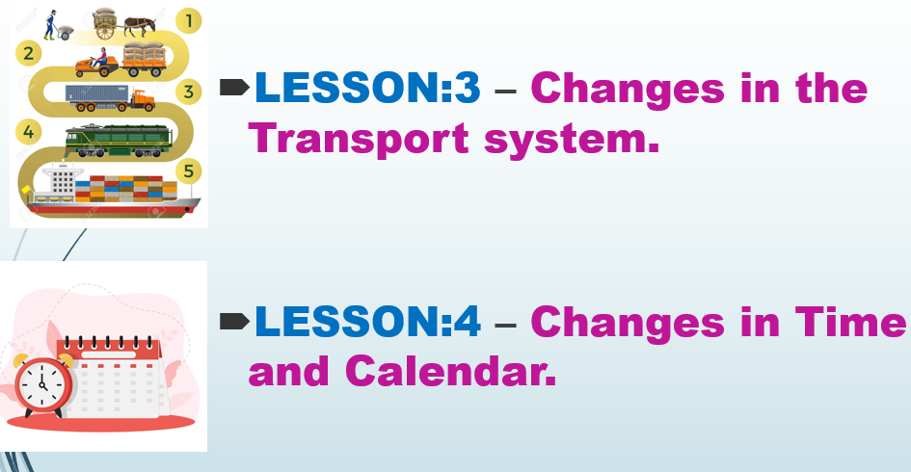

Slide 7

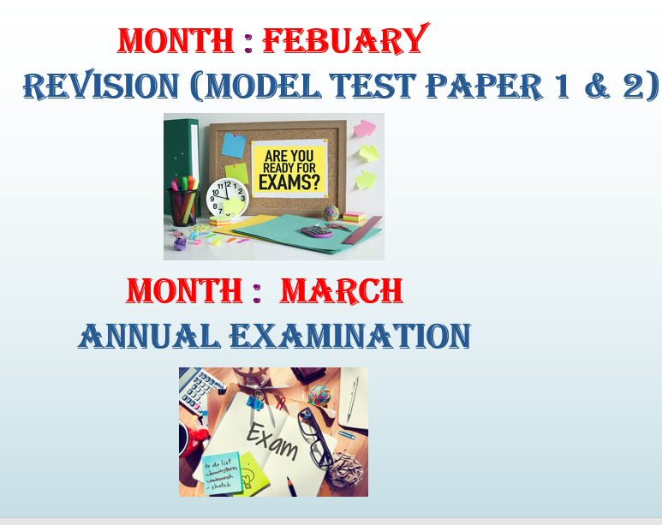
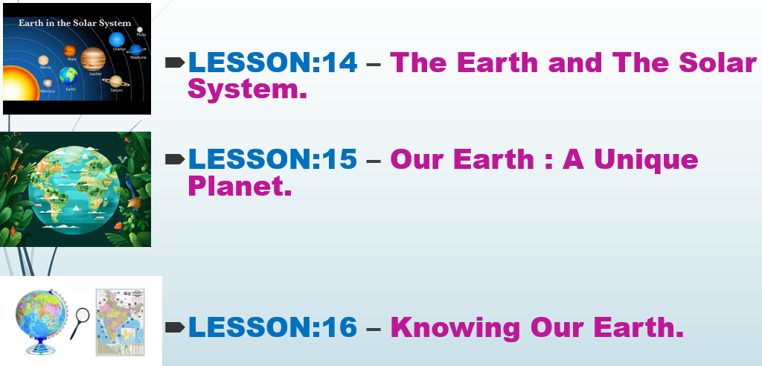
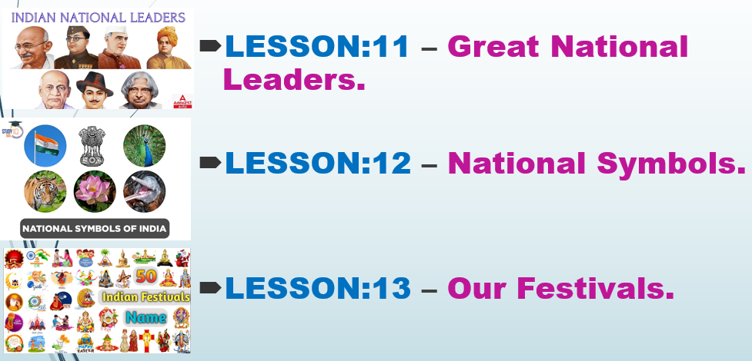

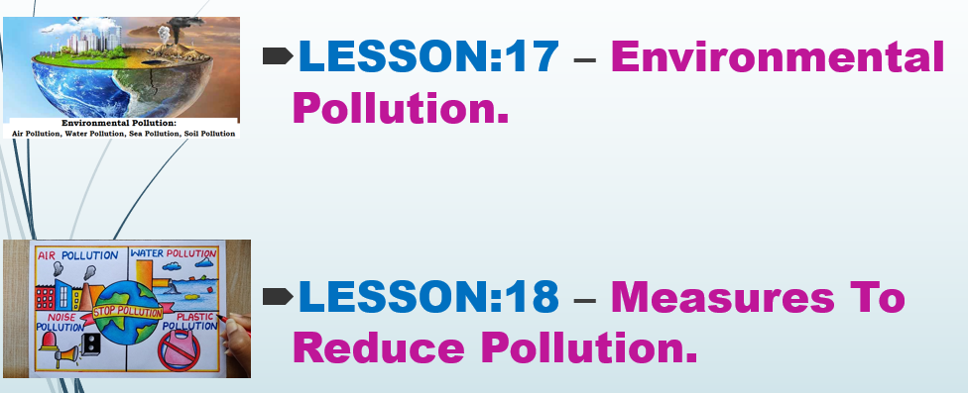

Slide 8

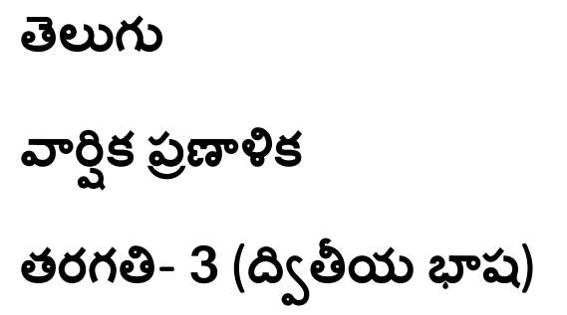
II LANGUAGE

Slide 9
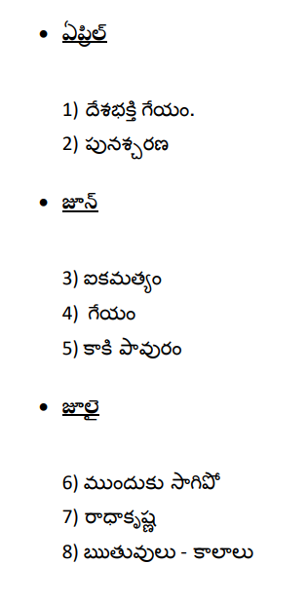
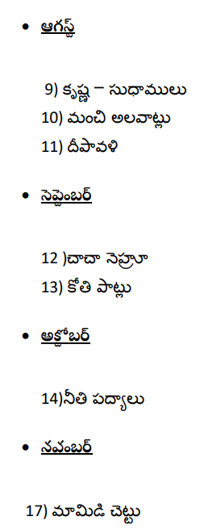
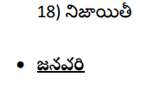
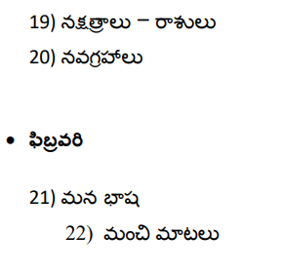

Slide 10

III LANGUAGE

Slide 11
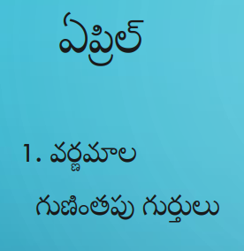
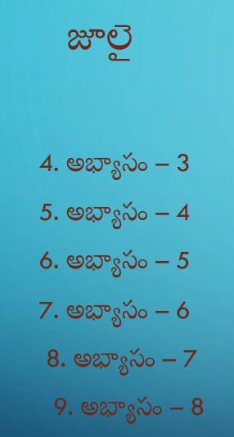
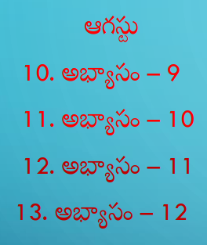
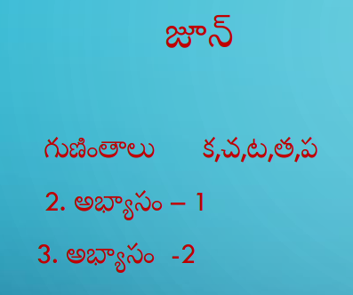


Slide 12
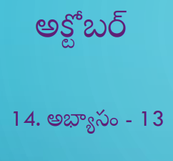
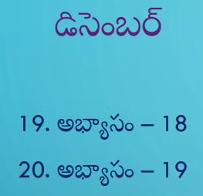
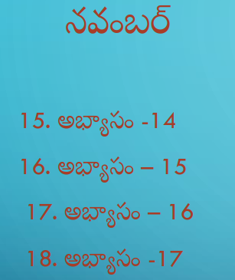
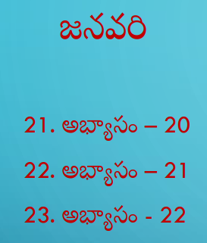


Slide 13

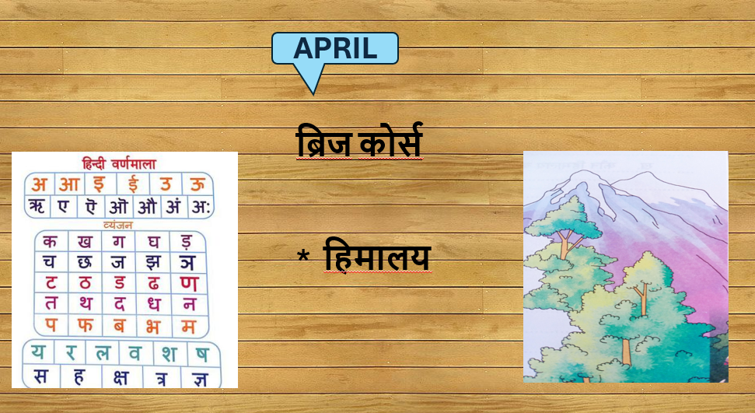
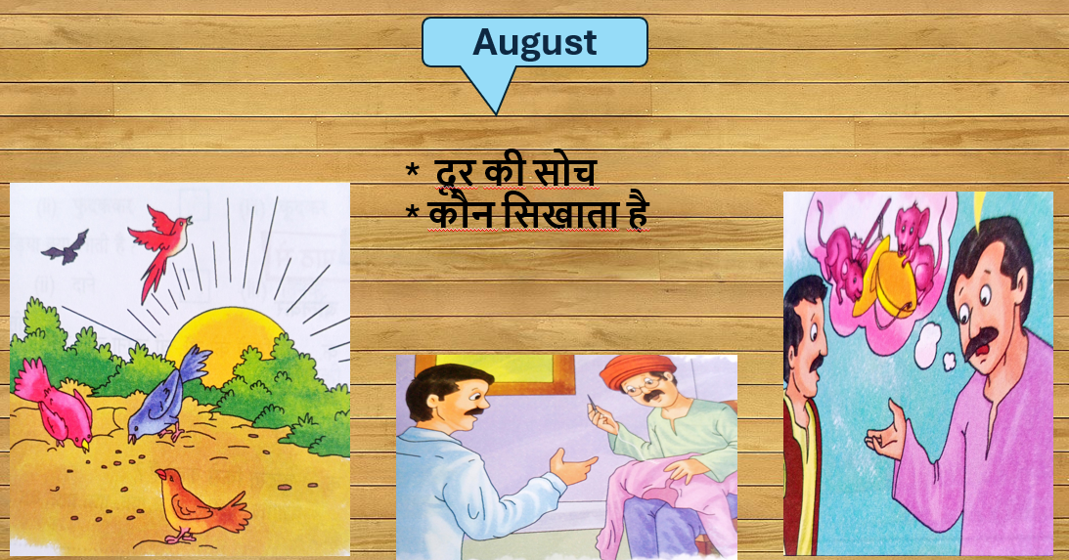
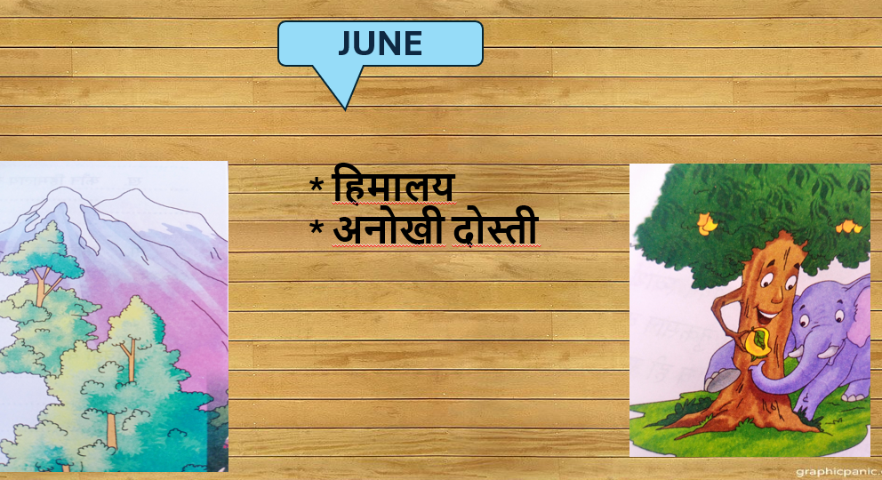
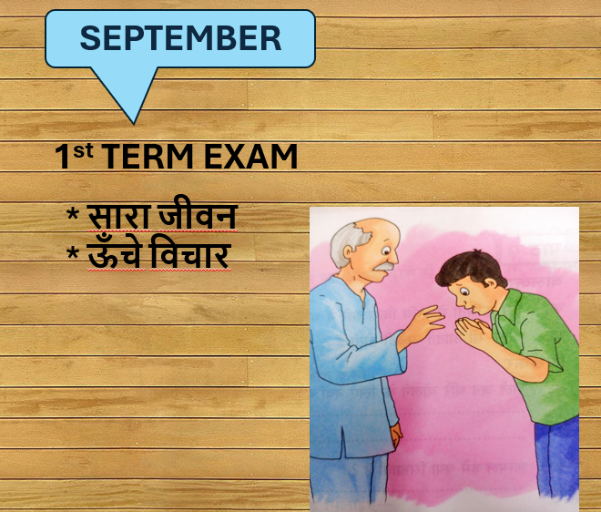
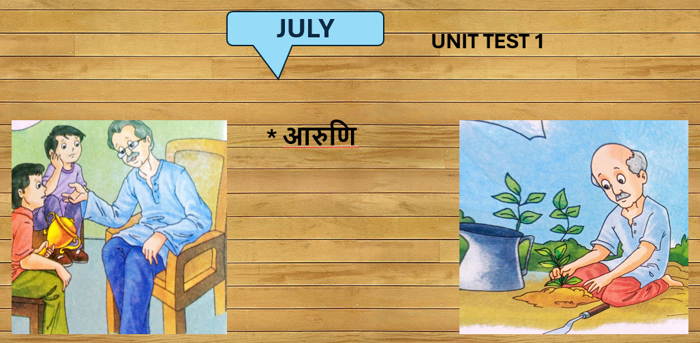

Slide 14
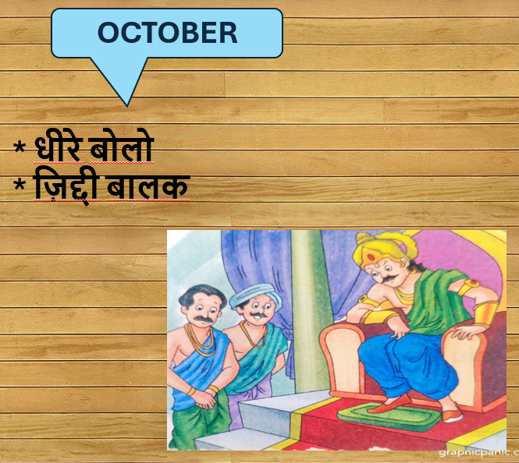
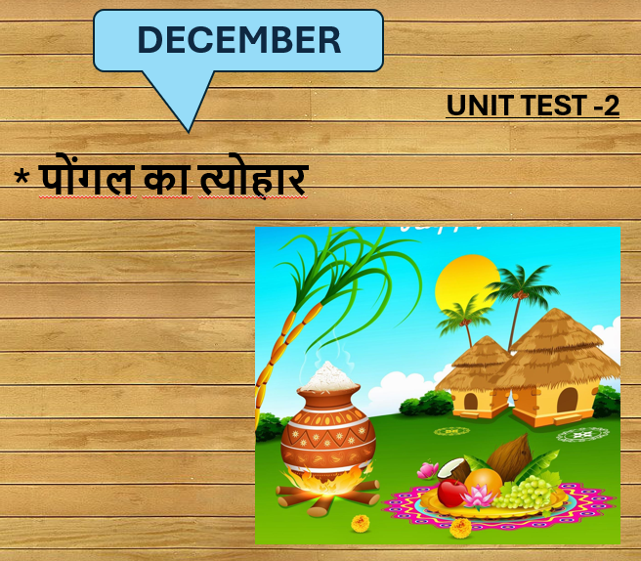
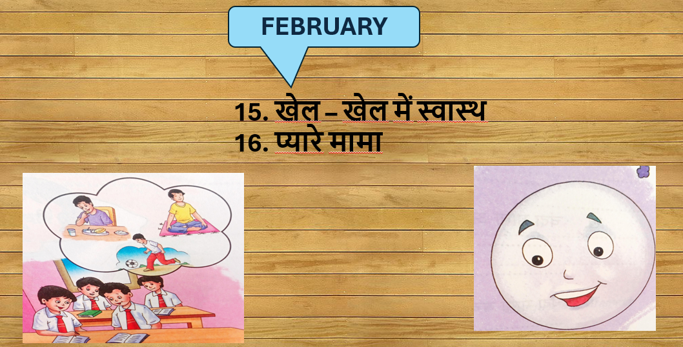
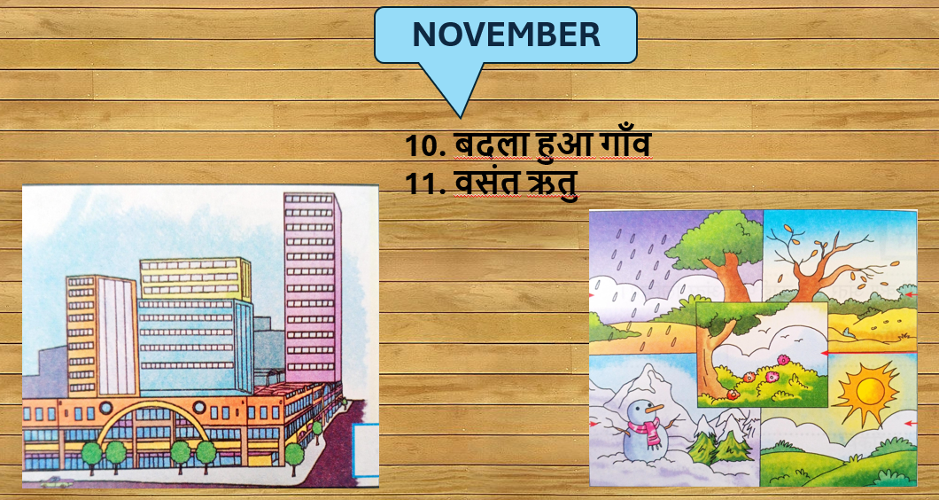
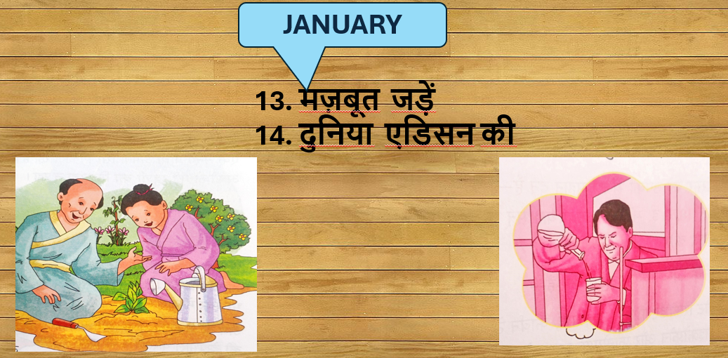
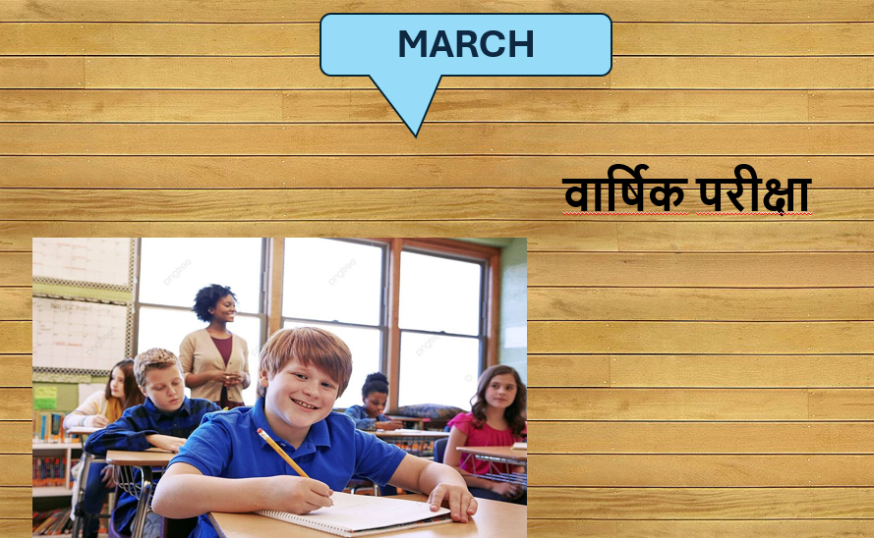

Slide 15
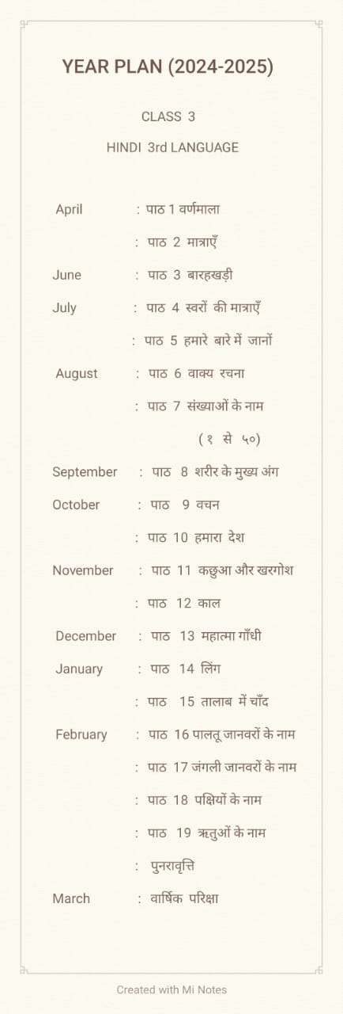


Slide 16


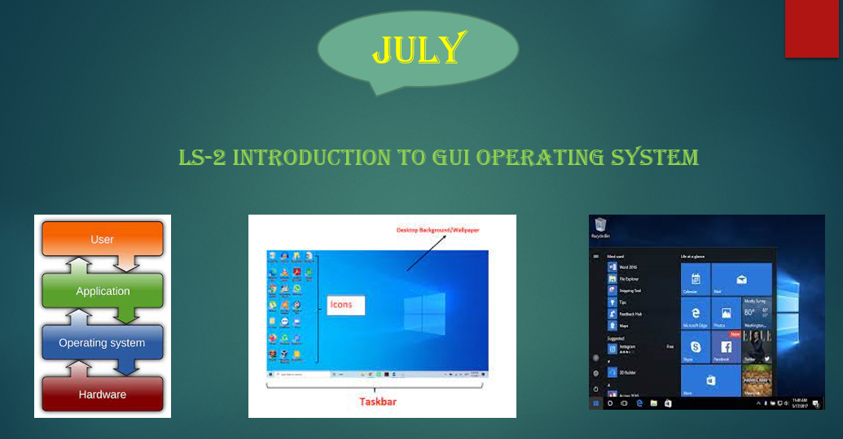

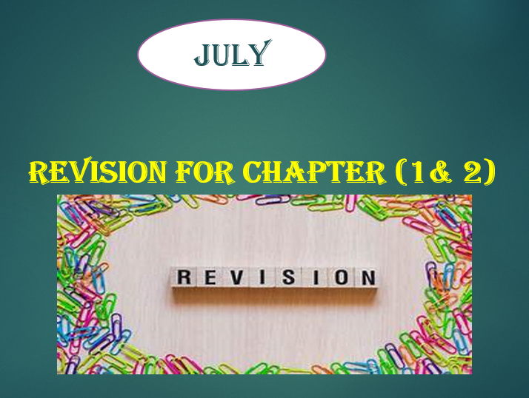

Slide 17
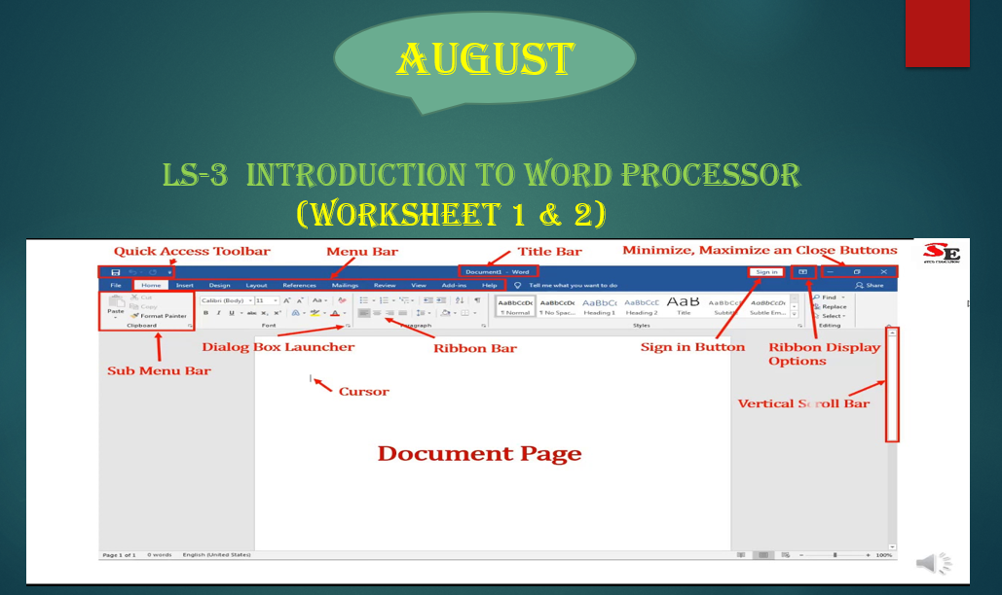
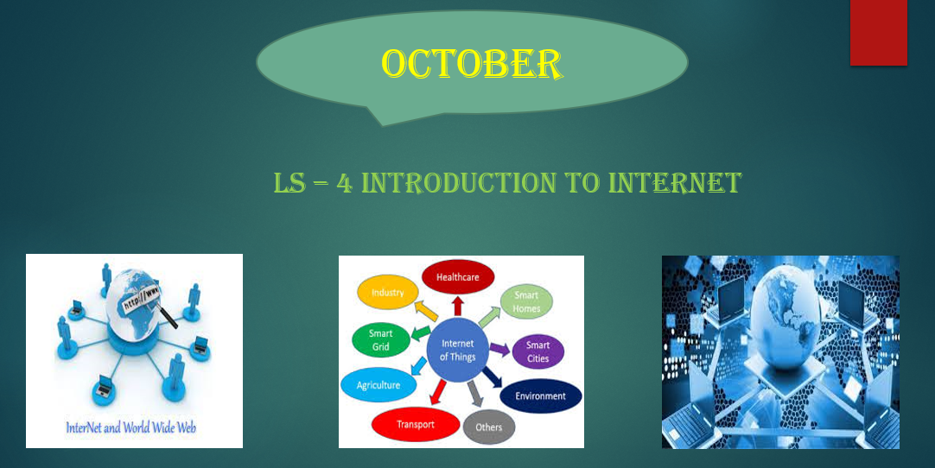
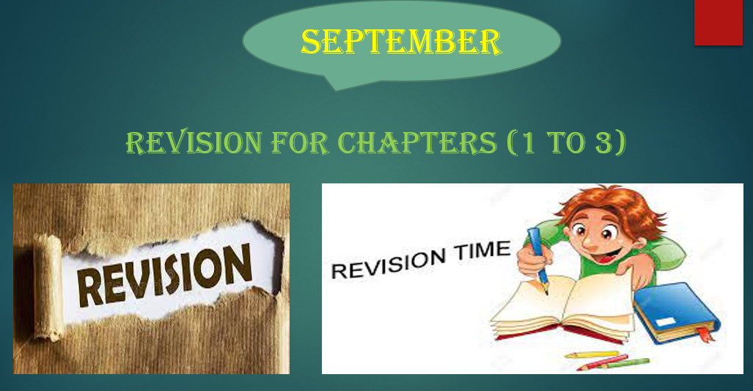
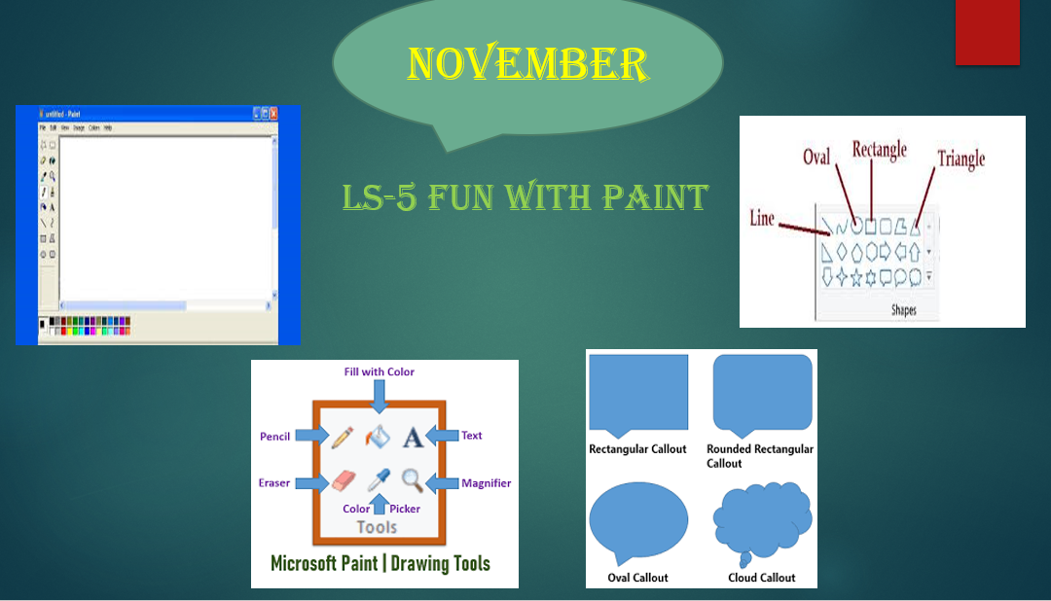

Slide 18
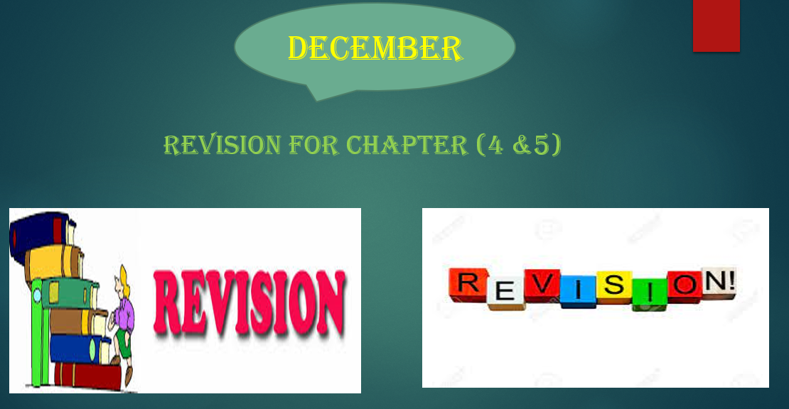
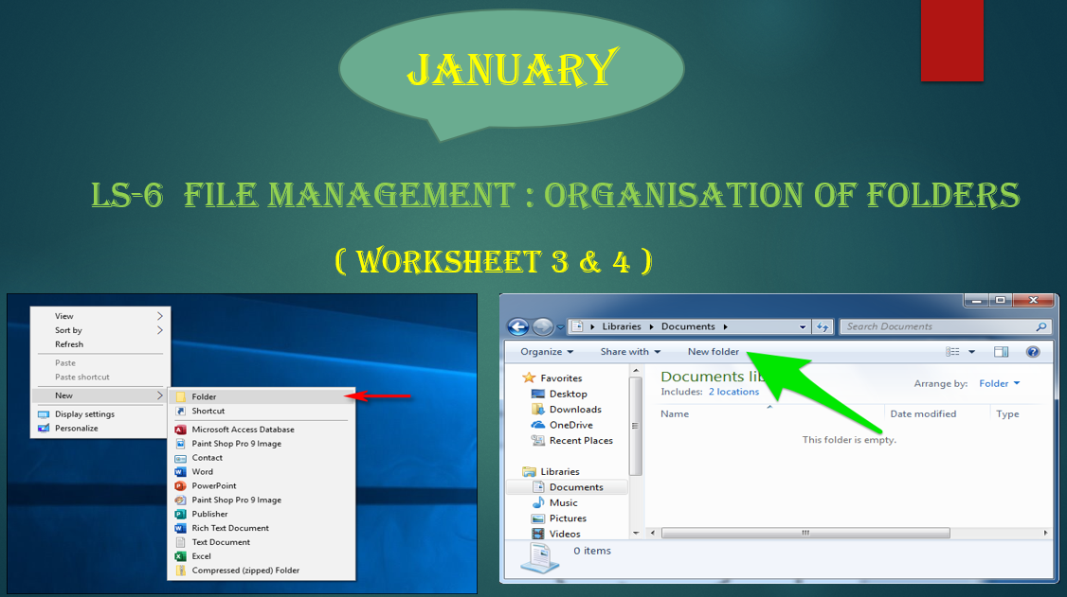
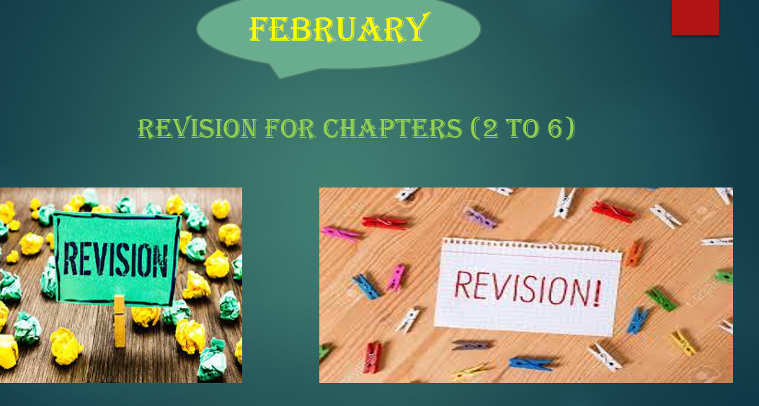

Slide 19


