Slide 1

CLASS-2 YEAR PLAN
2024-2025

Slide 2

Month | Lesson/Poem | Grammar
June | Ls1. Polly Helps a Friend Ls2. Nobody Helps a Friend (Comprehension on Camping) | Ls. 1Nouns Ls. 17 The Sentence Ls. 18 Punctuation
July | Ls3. Amit makes a Friend. Picture Composition | Ls. 2One and Many Ls 6Pronouns Comprehension :- The Little Duckling
August | Ls4. Home Sweet Home | Ls.7 Being Verbs Ls. 8 Having Verbs Vocabulary - Similar Words, Opposites
September | Mother Earth | Ls. 13Adverbs Ls. 3 A, An and The Ls. 15 Prepositions Picture Composition

Slide 3
October | End of Envy | Possesives Comprehension:- 1. On the Beach 2.The Floating Unicorn
November | I use my words | Ls.11 Simple Presentt Tense Ls.12.Present ContinuousTense Vocabulary :- Compound Words Words that go together
December | Why its Rains | Adjectives Comparison of Adjectives Comprehension :- It's my Food

Slide 4
January | First Drum | Tenses – Simple Past Tense/ Past Continuous Tense Joining Word Vocabulary :- One Word Subsitution People and the Work They Do.
February | Rainbow Fairies | Comprehension :- Ls. 5The Rabbit and thr Lion. Ls. L I Like the Zoo

Slide 5
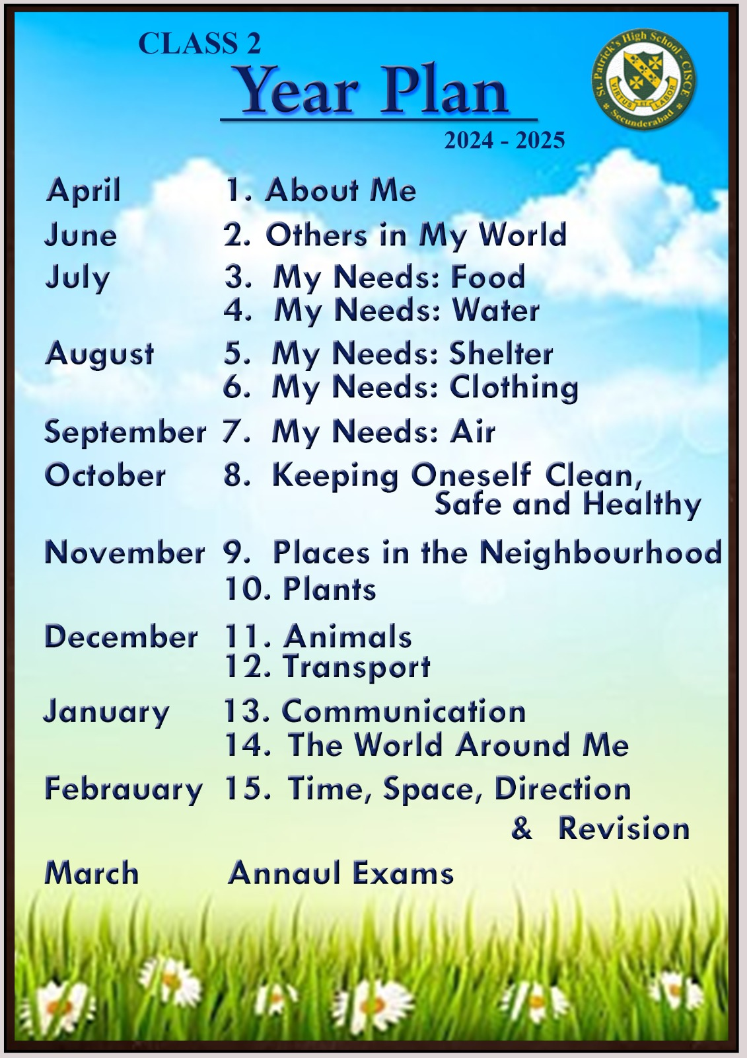


Slide 6
MATHEMATICS
Month | Lesson
March - April | Ls 1 : ( Numbers upto 99 )Ls 2 : ( Numbers upto 999 )
June | Ls : 2 ( Numbers upto 999 continuation ) Ls : 3 ( Addition )
July | Ls : 3 ( Addition continuation ) Ls : 4 ( Subtraction )
August | Ls : 9 ( Measurement of length ) Ls : 10 (Measurement of mass )
September | Ls : 11 (Measurement of capacity ) Ls : 15 ( Patterns )
October - November | Ls : 5 ( Multiplications ) Ls : 12 ( Time ) Ls 13 : ( Money )
December | Ls : 14 ( Data handling )
January | Ls 6 : ( Divisions ) Ls : 7 ( Fractions )
February | Ls : 8 ( Shapes )

Slide 7

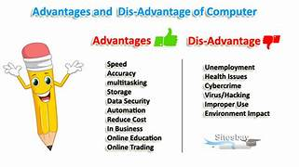
COMPUTER
JUNE
LESSON-1
COMPUTER – AN ELECTRONIC DEVICE

Slide 8
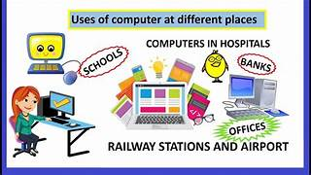
JULY
LESSON-2
ROLE OF COMPUTERS

Slide 9

JULY
REVISION FOR CHAPTER (1 & 2)

Slide 10
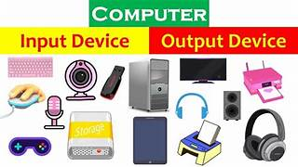
AUGUST
LESSON-3
INPUT AND OUTPUT DEVICES

Slide 11

SEPTEMBER
REVISION FOR CHAPTER (1,2 & 3)

Slide 12
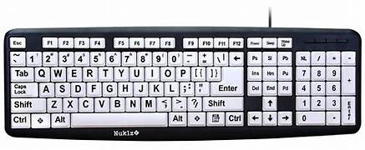
OCTOBER
LESSON-4
KEYBOARD – SPECIAL KEYS

Slide 13
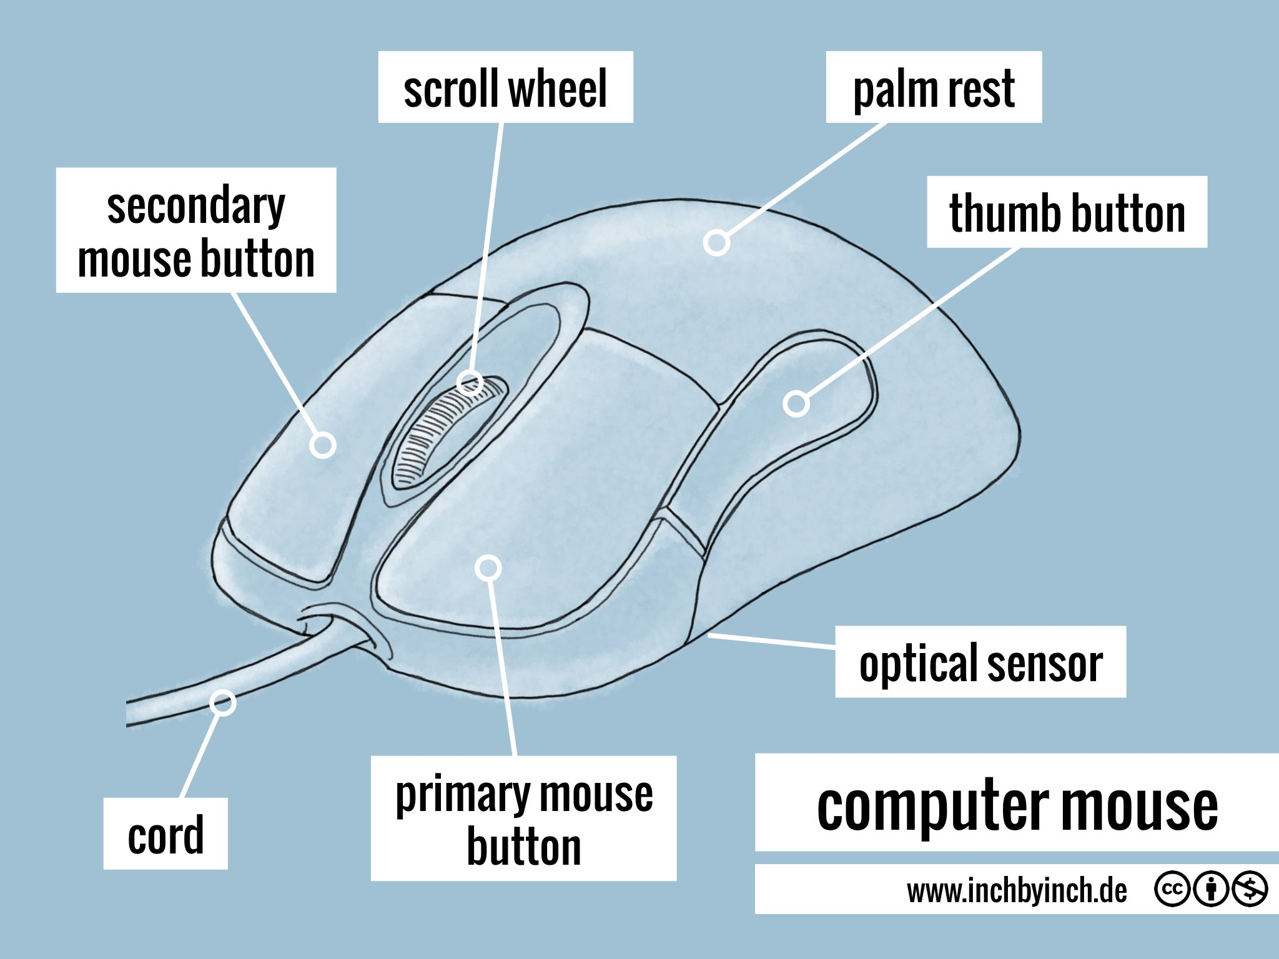
NOVEMBER
LESSON-5
MOUSE – AN INPUT DEVICE

Slide 14

DECEMBER
REVISION FOR CHAPTER (4 & 5)

Slide 15
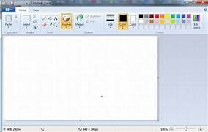
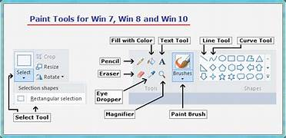
JANUARY
LESSON-6
INTRODUCTION TO PAINT

Slide 16
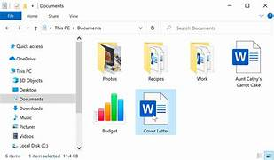
JANUARY / FEBRUARY
LESSON-7
FILE MANAGEMENT : AN INTRODUCTION

Slide 17

FEBRUARY
REVISION FOR CHAPTER (3 to 7)

Slide 18
HINDI 2nd LANGUAGE
APRIL***** पाठ- 1 हमको दो वरदान
JUNE****** पाठ -2 चीनू चींटी [(सुलेख माला ]
JULY***** पाठ – 3 अभ्यास की शक्ति
AUGUST**** पाठ -5 नकुल की दादी
SEPTEMBER**** पाठ – 7 जी करता जोकर बन जाॐ
OCTOBER***** पाठ–8 अनोखा रक्षाबंधन
NOVEMBER***** पाठ – 9 सुनो हमारी बात
.. पाठ -10 नीम और गुलमोहर
DECEMBER**** पाठ -11 मैं हूँ माटी का फ्रिज
JANUARY***** पाठ – 11 बादल को चिट्ठी
FEBRUARY***** पाठ -12 गुब्बारे
MARCH***** वार्षिक परीक्षा

Slide 19
HINDI 3rd LANGUAGE
APRIL***** वर्णमाला
JUNE****** दो वर्णोंवाले शब्द
तीन वर्णोंवाले शब्द
JULY****** चार वर्णोंवले शब्द
मात्राओं का ज्ञान
आ की मात्रा T
AUGUST****** इ की मात्रा -f
ई की मात्रा -ॽ‌
उ की मात्रा - ७
SEPTEMBER**** * ऊ -की मात्रा - -
ऋ - की मात्रा व्‍
ए - की मात्रा
OCTOBER***** ऐ की मात्रा v
. ओ की मात्रा ॊ
औ की मात्रा ॏ

Slide 20
HINDI 3rd LANGUAGE
NOVEMBER***** अं की मात्रा ॑ [अनुस्वार]
चन्द्र बिन्दू , विसर्ग :
DECEMBER द्वित्व अक्षर संयुक्ताक्षर
वाक्य संरचना प्रयोग
अंक
JANUARY***** पक्षियों के नाम
जानवरों के नाम
फलों के नाम
FEBRUARY***** सब्जियों के नाम
हमारे देश
शरीर के अंग
MARCH***** पुनरावृत्ति ,वार्षिक परीक्षा

Slide 21
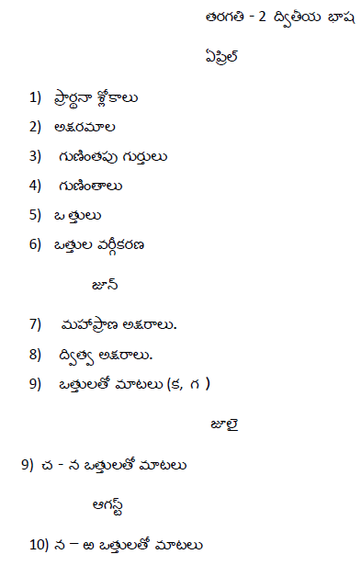
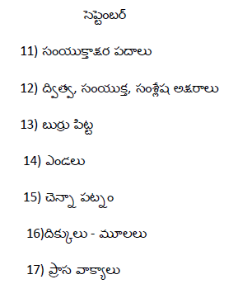

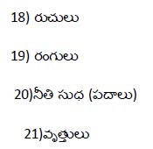
TELUGU 2nd LANGUAGE

Slide 22
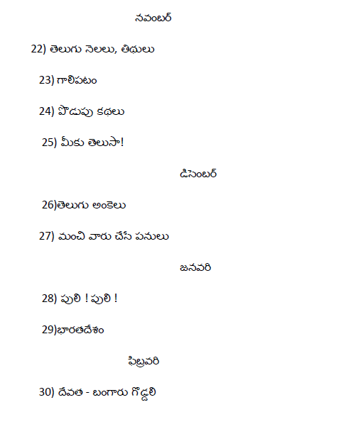
TELUGU 2nd LANGUAGE

Slide 23
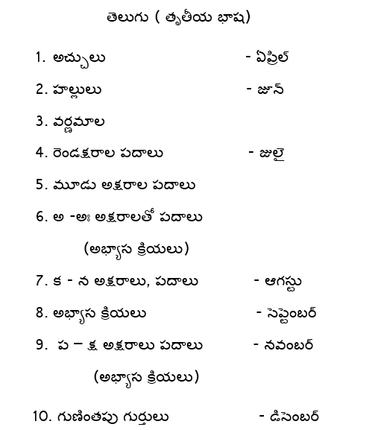
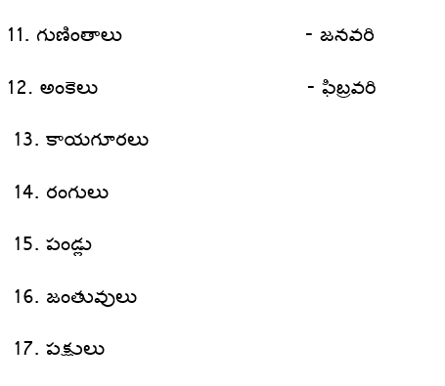
Telugu 3rd language

Slide 24


